Slide 1

02/14/2025
Predicting Customer Behavior by Web-scraping Data
- by Jignesh More

Slide 2
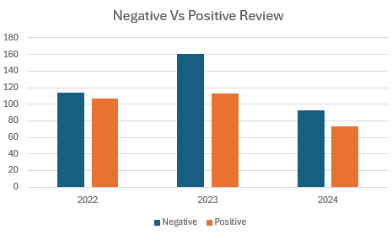
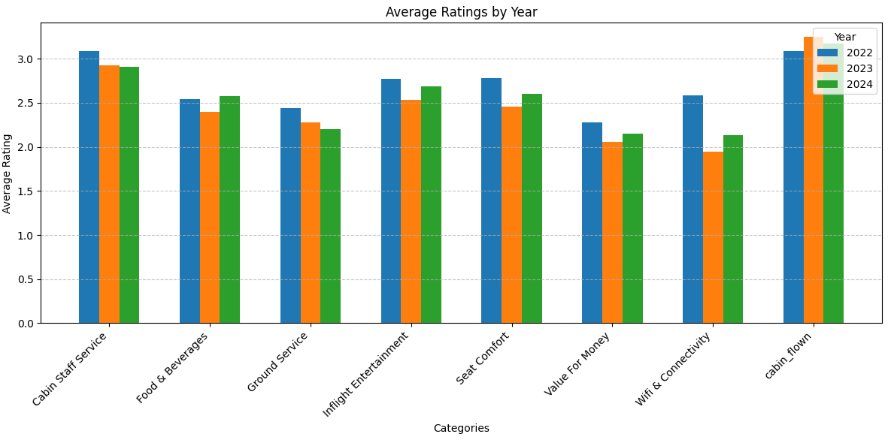

Overall INSIGHTS FROM CUSTOMER REVIEWS
Out of 800 total records, reviews from Last 3 Years were considered (663 reviews)
~56% comment as Negative Overall based on Sentiment Analysis
2024 review were less by 40% vs 2023, along with Negative feedback.
In 2024, British Airline enhanced customer satisfaction by improving at 5 services out of 8 compared to 2023, as mentioned on this chart

Slide 3
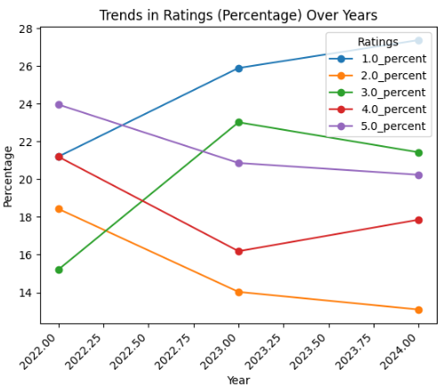
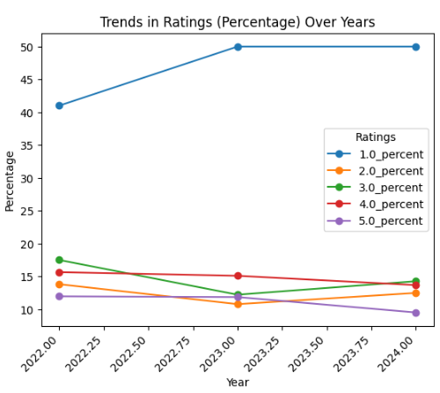
Detail INSIGHTS FROM CUSTOMER REVIEWS
Cabin Staff Service
Ground Service

Slide 4
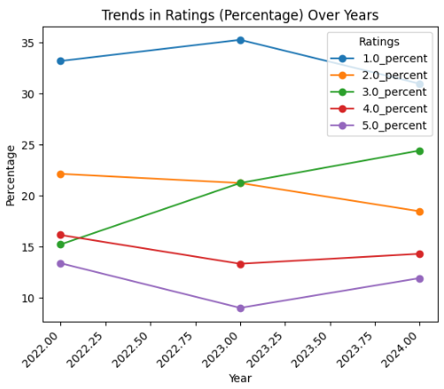
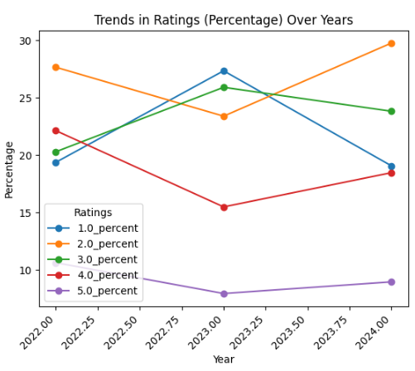
Detail INSIGHTS FROM CUSTOMER REVIEWS
Food & Beverage Service
In-Flight Entertainment

Slide 5
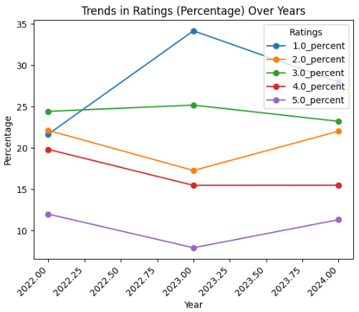
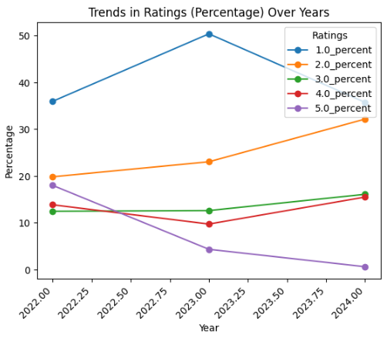
Detail INSIGHTS FROM CUSTOMER REVIEWS
Seat Comfort
Wi-fi Connectivity

Slide 6
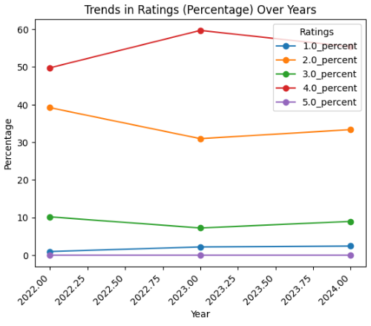
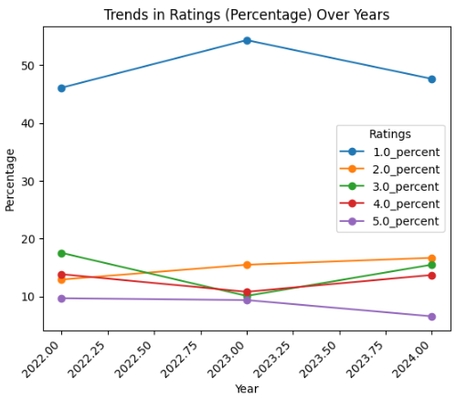
Detail INSIGHTS FROM CUSTOMER REVIEWS
Cabin Flown
Value to Money

Slide 7
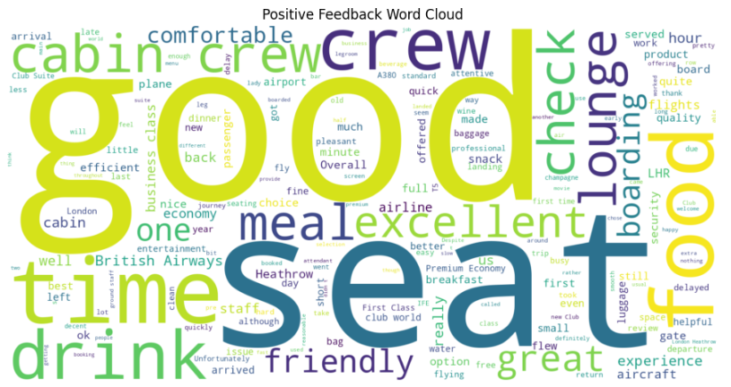
Detail INSIGHTS FROM CUSTOMER REVIEWS
Positive Feedback Word Cloud

Slide 8
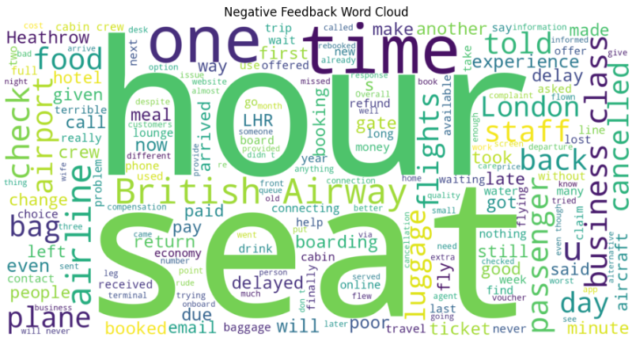
Detail INSIGHTS FROM CUSTOMER REVIEWS
Negative Feedback Word Cloud

Slide 9
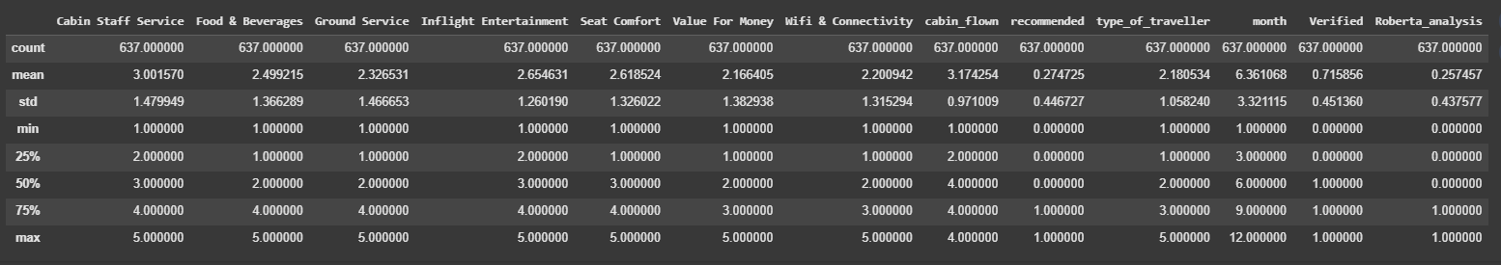
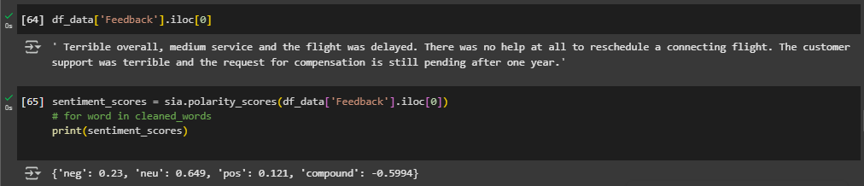

Detail INSIGHTS FROM CUSTOMER REVIEWS
Model Data Description
Lost 26 records as unable to process Sentiment Analysis
Sentiment Analysis
Chosen Roberta Pretrained Model from Hugging Face over VADER sentiment analysis

Slide 10
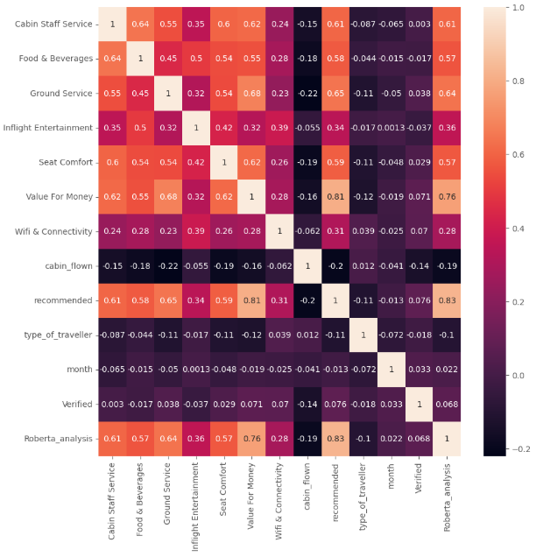
Detail INSIGHTS FROM CUSTOMER REVIEWS
Correlation Chart
post performing Feature selection
Linear Regression Result
Mean Squared Error: 0.03780 R-squared: 0.8150
Ridge Regression Result
Mean Squared Error: 0.03781 R-squared: 0.8150
Chosen Ridge Regression over Linear Regression

Slide 11
Detail INSIGHTS FROM CUSTOMER REVIEWS
An in-depth analysis of the data reveals a decline in ratings for Cabin Staff Service in 2024 compared to 2023, suggesting a potential drop in service quality that warrants further investigation. In contrast, Food & Beverages ratings demonstrated an upward trend, reflecting improved customer satisfaction in this area. However, Ground Service remains a significant challenge, consistently receiving low ratings, including notable feedback at the lowest score of 1 out of 5.
Encouragingly, marginal improvements were observed in the ratings for Inflight Entertainment and Seat Comfort, signaling progress in these areas. The Value for Money rating also increased in 2024 relative to 2023, although opportunities for further enhancements remain. Notably, Wi fi & Connectivity, which faced substantial issues in 2023, experienced the most significant improvement, reflecting effective measures to address past concerns.
There has been a slight shift in passenger preferences, with more people moving from Economy Class to other classes. This shift could potentially explain the slight improvement in ratings
Although the feedback count in 2024 is lower, there was a slight increase in the number of non-verified users compared to the previous year. Additionally, the recommendation count saw a modest rise compared to 2023.
A decline in all ratings might indicate reduced passenger volume, a change in the survey process, or degraded service quality.

Slide 12

Detail INSIGHTS FROM CUSTOMER REVIEWS
Recommendation in 2025:
Ensure that the decline in service quality is reversed.
Focus on areas receiving moderate satisfaction (ratings of 3 and 4).
Increase survey participation to gather meaningful data.
Improve services for higher satisfaction and consistent ratings.

